Slide 1

ONAP Cloud Native
(For LFN Cloud Native messaging)
- Draft 0.4
This deck will be used for generic, industry talks/keynotes => ONS, LFN Webinar, press release,
etc. and re-used/re-adjusted by ourselves ;-)
Slides should be visual, punchlines – see Marketing Honolulu deck
Need to include speaker notes
ONAP
The Linux Foundation

Slide 2



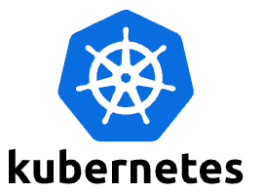
ONAP CNF Orchestration
Hybrid services CNF/VNF/PNF, leveraging open-source and standards
  Support Greenfield and Brownfield environment
  E.g., CNF on bare-metal, CNF on VM, VNF on VM, PNF
Day 0/1/2 configuration
  Not just infrastructure orchestration
  Configuration and Update
Standard alignment (ETSI,3GPP) and beyond (ASD)
  Evolve existing investment, no need to start from scratch
  Common Infrastructure for model/package onboarding, design and distribution
  Support both ETSI-Aligned and Cloud Native Orchestration
  5G slicing use case – 3GPP compliant
  https://wiki.onap.org/display/DW/CNF+Orchestration+Functional+Architecture
SOL001,
SOL004, SOL007
ASD
Onboarding & Design
Artifact Repository
(image, helm charts, etc.)
orchestration
Helm client
controller
CNF
VNF
K8S(CISM)
VIM
CIS
NFVI
Notes:
Missing Tata Consultancy if you consider Data from Oct 24th to June 8th => 35 !
If you consider data from Nov 7th (M1) to June 11th (Sign-Off): 34 org including Tata but no more ENEA AB

Slide 3
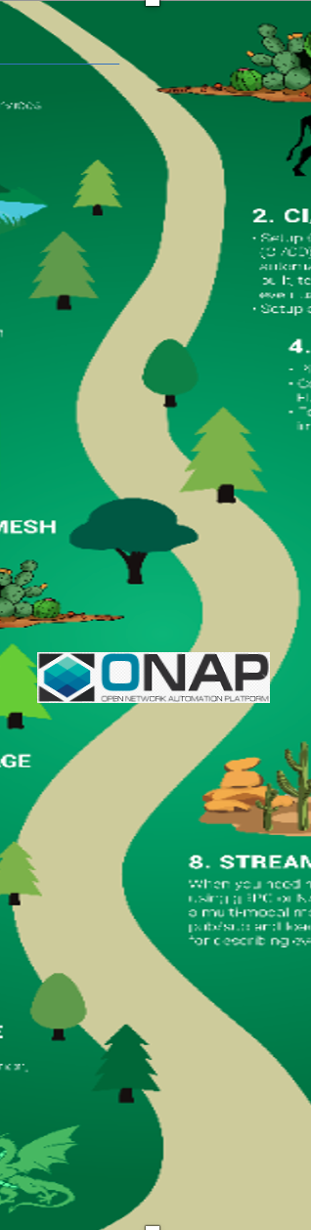
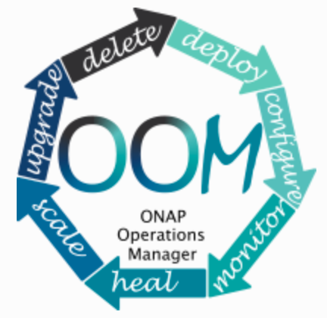











ONAP Functionalities and CNCF Conformance
  Containerization
  All the ONAP components are container-based
  OOM manages complete lifecycle of ONAP components, leveraging K8S ecosystem
  ONAP supports private, public and hybrid cloud infrastructures
  Onboarding & Design
Supporting VNF/CNF/PNF onboarding
Conforming to industry standard modeling and packaging
Designing Services and Resources
Distributing Service Packages to the subscribers
  Orchestration
Orchestrating network services and resources
Supporting hybrid services CNF/VNF/PNF, conforming to open-source and standards
Providing both ETSI-Aligned and Cloud Native Orchestration
Managing 5G slicing use cases – 3GPP compliant
Enabling flexible and custom BPMN workflows with scripts
Monitoring run-time workflows activities
Supporting plug-ins for various resource and controller adapters
Service-Mesh Proxy & Security
service
service
Ingress
egress
  Enable uniform and platform-level Service-Mesh Pattern Security by
  Leveraging open-source and CNCF projects, such as Istio, Envoy, Kubernetes Ingress and Egress, Keycloak
    Allowing security extensibilities with configurations/policies
    Supporting integration/deployment flexibilities with external IdAM and IdP
Observability & Analysis
App - Log
Generation
  Support open-source and standard-based Logging architecture by:
  Decoupling log generation from collection/aggregation/analysis processes
    Enabling pick-and-choose solutions for monitoring, aggregating, storing and visualization
    Providing logging reference implementation with Fluentbit, Fluentd, Elastic Search, Kibana
ONAP 5G Super Blueprints

Slide 4
ONAP Cloud Native Transformation
Enterprise E2E use cases
  K8S is widely used in enterprise environment
  Application orchestration, not just network function orchestration.
Cross-community
  LFN
    Anuket CI2
    XGVela
    EMCO
  LF Edge
    Akraino – future plans
  O-RAN (SC)
  SDOs – TMForum, ETSI, 3GPP
CI/CD
  Jenkins/Gihub/Sonar
Streaming/Messaging
  DMaaP (?), MSB
Distributed DB &Storage
  Etcd (OOF), etc.
Notes:
Missing Tata Consultancy if you consider Data from Oct 24th to June 8th => 35 !
If you consider data from Nov 7th (M1) to June 11th (Sign-Off): 34 org including Tata but no more ENEA AB

Slide 5
www.onap.org

Slide 6
Backup Slide
Notes:
Missing Tata Consultancy if you consider Data from Oct 24th to June 8th => 35 !
If you consider data from Nov 7th (M1) to June 11th (Sign-Off): 34 org including Tata but no more ENEA AB

Slide 7
ONAP Cloud Native
(For LFN Cloud Native messaging)
This deck will be used for generic, industry talks/keynotes => ONS, LFN Webinar, press release,
etc. and re-used/re-adjusted by ourselves ;-)
Slides should be visual, punchlines – see Marketing Honolulu deck
Need to include speaker notes
See the Next Page
Draft 0.5

Slide 8
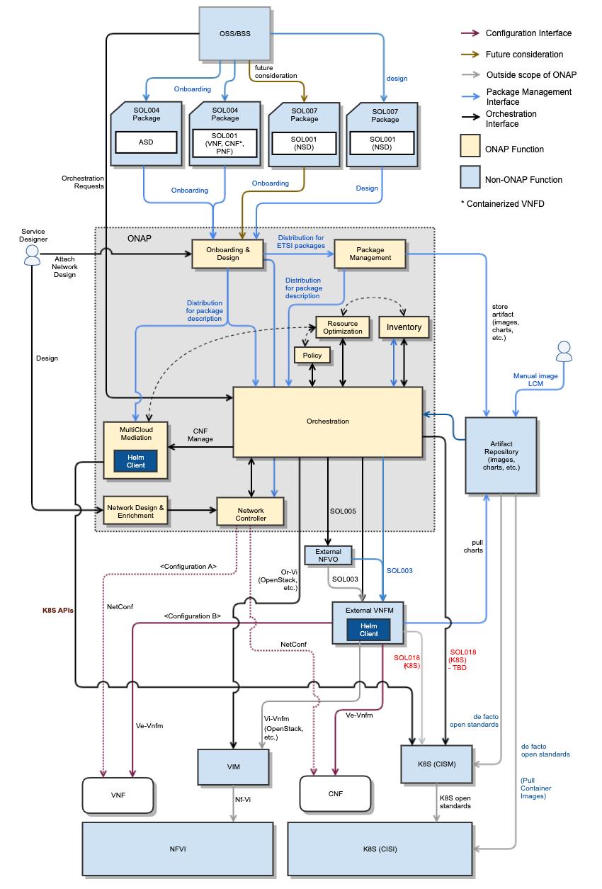
ONAP CNF Orchestration
Suggestion to remove all the arrows across all the boxes,
Rotate 90° the diagram, etc. + punch line/Keywords
about key features
<ETSI logo>
SOL001
SOL004, SOL007 + ASD
Hybrid services CNF/VNF/PNF
  Brownfield environment
Day 0/1/2 configuration
  Not just infrastructure orchestration
Standard alignment (ETSI,3GPP) and beyond (ASD)
  Evolve existing investment, no need to start from scratch
  5G slicing use case – 3GPP compliant
  https://wiki.onap.org/display/DW/CNF+Orchestration+Functional+Architecture
See the Next Page
SO

Slide 9
ONAP Cloud Native transformation
Flexibility for deploying just the necessary modules on K8S infrastructure
  ONAP OOM simplifying deployment of ONAP Modules Helm charts (pick & choose)
Leveraging functionality of the CNCF ecosystem
  Enable uniform and platform-level Service-Mesh Pattern Security by = Service Proxy, Discovery and Mesh
    Leveraging open-source and CNCF projects, such as Istio, Envoy, Kubernetes Ingress and Egress, Keycloak
    Allowing security extensibilities with AuthN/AuthZ configurations/policies
    Supporting integration/deployment flexibilities with external IdAM and IdP
  Support open-source and standard-based Logging architecture by: == Observability & Analysis
    Decoupling log generation from collection/aggregation/analysis processes
    Enabling pick-and-choose solutions for monitoring, aggregating, storing and visualization
    Providing logging reference implementation with Fluentbit, Fluentd, Elastic Search, Kibana
Enterprise E2E use cases
  K8S is widely used in enterprise environment
  Application orchestration, not just network function orchestration.
Cross-community
  LFN
    Anuket CI2
    XGVela
    EMCO
  LF Edge
    Akraino – future plans
  O-RAN (SC)
  SDOs – TMForum, ETSI, 3GPP
See the next Page
CI/CD
Jenkins/Gihub/Sonar
Streaming/Messaging
DMaaP (?), MSB
Distributed DB &Storage
Etcd (OOF), etc

Slide 10
ONAP Cloud Native transformation
Flexibility for deploying just the necessary modules on K8S infrastructure
  ONAP OOM simplifying deployment of ONAP Modules Helm charts (pick & choose)
Leveraging functionality of the CNCF ecosystem
  Enable uniform and platform-level Service-Mesh Pattern Security by = Service Proxy, Discovery and Mesh
    Leveraging open-source and CNCF projects, such as Istio, Envoy, Kubernetes Ingress and Egress, Keycloak
    Allowing security extensibilities with AuthN/AuthZ configurations/policies
    Supporting integration/deployment flexibilities with external IdAM and IdP
  Support open-source and standard-based Logging architecture by: == Observability & Analysis
    Decoupling log generation from collection/aggregation/analysis processes
    Enabling pick-and-choose solutions for monitoring, aggregating, storing and visualization
    Providing logging reference implementation with Fluentbit, Fluentd, Elastic Search, Kibana
service
service
Ingress
egress
App - Log
Generation
CI/CD
Jenkins/Gihub/Sonar
Streaming/Messaging
DMaaP (?), MSB
Distributed DB &Storage
Etcd (OOF), etc

Slide 11
ONAP Cloud Native transformation
Enterprise E2E use cases
  K8S is widely used in enterprise environment
  Application orchestration, not just network function orchestration.
Cross-community
  LFN
    Anuket CI2
    XGVela
    EMCO
  LF Edge
    Akraino – future plans
  O-RAN (SC)
  SDOs – TMForum, ETSI, 3GPP
CI/CD
Jenkins/Gihub/Sonar
Streaming/Messaging
DMaaP (?), MSB
Distributed DB &Storage
Etcd (OOF), etc

Slide 12
ToDO
Create a block diagram
Add short description for the security/logging items in the second slide – re-group bullets in the list
Add diagram to highlight the use of CNCF components (slide 3) – Get inspiration from the CNCF trail map - https://wiki.onap.org/pages/resumedraft.action?draftId=93004635&draftShareId=b4cf7c15-b975-4e3e-b25e-be3812e8c37b&
Add forward looking hints about future cloud-native roadmap

Slide 13
