Slide 1
Building modern cloud-native network services with ONAP
Panel
@twitter

Slide 2

The Open Networking Automation Platform (ONAP) is a comprehensive platform for real-time, policy-driven service orchestration and automation for networks and edge services.
It is being developed as an open source software project with neutral governance under the auspices of The Linux Foundation.
  Started back in early 2017, it had 8 successful releases, and is working towards completion of the 9th.
  Over 200 developers from 25 organizations
Adopted by tier-1 operators worldwide. Developing Enterprise use cases
  Orchestration for virtual and physical network functions
  Use cases include 5G slicing, Carrier VPN, and zero-touch networks

Slide 3
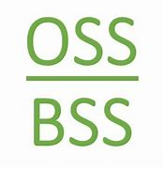

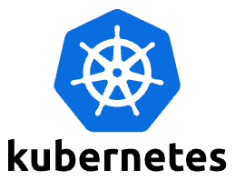
ONAP CNF Orchestration Journey
Hybrid services CNF/VNF/PNF, leveraging open-source
and standards
  Support Greenfield and Brownfield environment
  E.g., CNF on bare-metal, CNF on VM, VNF on VM, PNF
Day 0/1/2 configuration
  Not just infrastructure orchestration
  Configuration and Update
Standard alignment (ETSI, 3GPP) and beyond (ASD)
  Evolve existing investment, no need to start from scratch
  Common Infrastructure for model/package onboarding,
  design and distribution
  Support both ETSI-Aligned and Cloud Native Orchestration
  5G slicing use case – 3GPP compliant
SOL001,
SOL004, SOL007
ASD
Onboarding & Design
External Artefacts/
Repository
(image, helm charts, etc.)
Orchestration
Helm Client
Controller(s)
PaaS/IaaS/CaaS
CNF
VNF
k8s (CISM)
VIM
CIS
NFVI
3

Slide 4
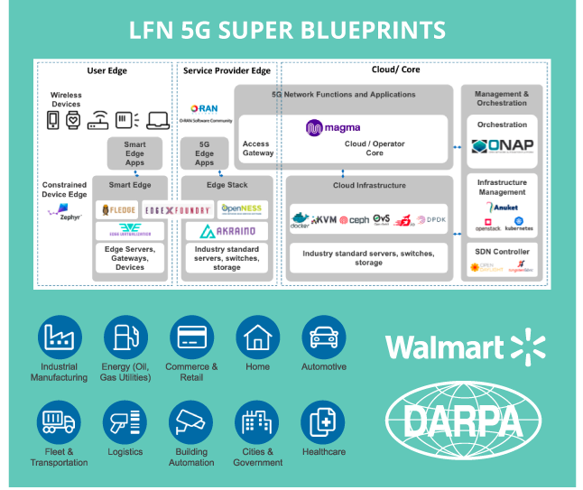
Orchestrating a Cloud Native Network Service
The 5G Super Blueprint is designed to demonstrate how real-life e2e services can be orchestrated using mature, open-source based technologies
The orchestrated service is a cloud based 5G wireless network including RAN and Packet Core
  Applicable use cases may include private 5G for industrial, commercial or government use cases
  Interested parties include Walmart and DARPA
ONAP is a key component in this solution
  Used for designing and deploying e2e cloud native network functions (CNFs) as well as VNF/PNF
  Performing Day 0/1/2 configuration
  Used for service assurance using closed loop automation

Slide 5
Backup

Slide 6
VNFs Architecture
CNF Architecture
VNFs/PNFs
OSS/BSS
CNFs
VNFs
OSS/BSS
MANO/SMO
KubeVirt / Airship SIP/ViNO /
OpenStack
MANO/SMO
Multi-Cloud and/or Bare Metal
Kubernetes
Bare Metal
Any Cloud
Notes:
Several variations of VNF implementation exists on multi-cloud with Standards based OSS/BSS integration through MANO frameworks like ONAP under LF Networking. Current implementations include ONAP running on K8s and a variety of Clouds including Openstack
CNF Architecture diagram is aligned to ETSI with VIM as K8s and options to run CNFs on K8s and Bare Metal as well as hybrid (brownfield) scenarios with VNF and CNF on any cloud while still utilizing the Standard de-facto implementation of OSS/BSS on MANO like ONAP.

