Slide 1
TOSCA Model for Closed Loop in ONAP - Proposal
Ericsson
Fei Zhang, Michela Bevilacqua, Liam Fallon, Calin Curescu
2020-04-15 – PA16

Slide 2
Closed Loop Model in TOSCA
Scope:
  Identify software components/apps and their relations to be deployed in ONAP for the execution of a closed loop instance at run time.
Ambition:
  Setup a general TOSCA model of a Closed Loop
    In Rel G, propose simple TOSCA based application models for support in CLAMP, DCAE and Policy (and other projects)
    In further release, propose E2E closed loop model covering any Apps/Apps extensions involved in ONAP control loop
TOSCA Model
EVE1
App_1
EVE2
App_2
EVE3
App_3
EVE4
App_n
EVEn+1
Application: a software component providing run-time service
Compound application(yellow box): a combination of sw apps
EVE: a generical event sent by an application provider to an application consumer

Slide 3
Closed Loop Model: today and evolution
APP x
SO
DCAE
ClosedLoop
xNF/App
Artifact Y
VES
PolicyFramework
SDNC/APPC
xNF/App
APP1
APP2
APEX APP
SO
APPy
Conn(opt)
Artifact
SDNC/APPC
Closed Loop in ONAP Today
  A closed loop includes only microservices to be deployed in DCAE and policy rules
  for the policy framework
Closed Loop concept can be extended and generalized including for instance
application responsible to progress the execution of the triggered action (e.g. SO, Controller)

Slide 4
Tosca Proposal

Slide 5
Closed Loop TOSCA Structures
ClosedLoop_1
APP_1
event producer cap
cap
ClosedLoop_2
req
ClosedLoop_3
APP_1
event producer cap
APP_2
Application
cap
cap
APP_1
event producer cap
cap
event consumer cap
cap
cap
req
APP_2
cap
Relay
req
cap
req
Connectivity
req
req
APP_2
cap
event consumer cap
APP_3
cap
event consumer cap
cap
cap

Slide 6
Closed Loop TOSCA Structure (APP abstract)
ClosedLoop_4
APP abstract
event producer cap
cap
APP_1
req
APP_2
cap
cap
event consumer cap

Slide 7
Closed Loop TOSCA Structure (Closed Loop abstract)
ClosedLoop_5
(abstract)
cap
Topology
Nodes
links
ClosedLoop_1
APP_1
event producer cap
cap
req
APP_2
cap
cap
event consumer cap

Slide 8
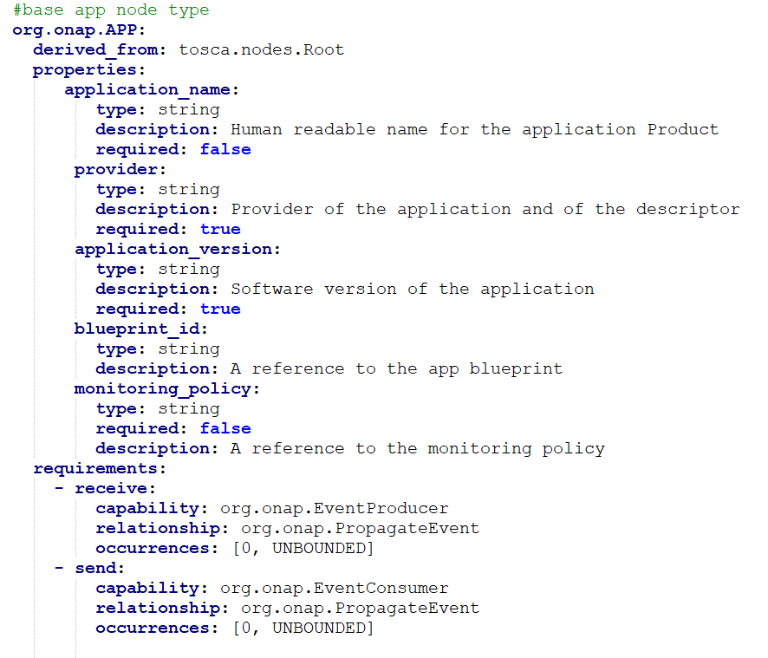
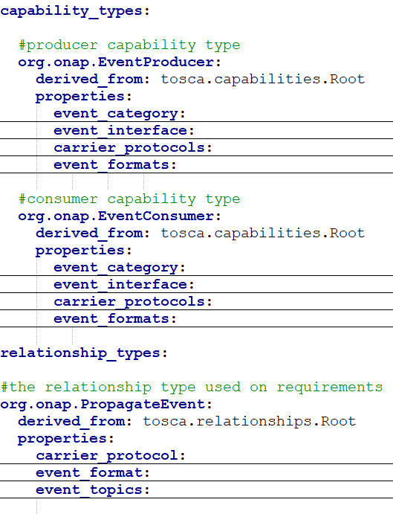
BASIC APP Node Type
APP_2
cap
APP_1
req

Slide 9
Closed Loop LifeCycle
Time t0: CLOSED LOOP DESIGN:
create node types.
Ex: Create PMSH node type derived by the generic APP node type
Time t2: CLOSED LOOP INSTANCE CREATION:
input parameters can be added .
A CL instance is created then and stored.
Time t1: CLOSED LOOP CREATION:
create topology and node template
Ex. A specific PMSH node template
Time t3: CLOSED LOOP INSTANCE DEPLOYMENT/ACTIVATION
Time t4 : CLOSED LOOP INSTANCE is running
e.g. DCAE GUI/MOD and/or SDC
e.g. DCAE GUI/MOD
and/or CLAMP ?
CLAMP
ONAP platform

Slide 10
Closed Loop Blueprint vs Closed Loop Instance
1 CL blueprint
CL tosca blueprint
1 single tosca blueprint.
Default properties.
CP1
Multiple CL instances can be created based on the same CL tosca blueprint
Where:
Configuration/Monitoring Policy paramenters will be provided as an input parameter
Input parameters
CL blueprint
CP2
Assumption: CLs are using the same consumers/producers
UC3
UC1,2,4

Slide 11
PM control UC analysis

Slide 12
UC: PM control
ClosedLoop
SO
- subscriptionName
- nfTypeModelInvariantId
- nfFilter
- administrativeState
- fileBasedGP
- fileLocation
- measurementGroup
CLAMP support for APEX operational policies is under development
CLAMP
AAI
DMAAP topic in Frankfurt
DCAE
Policy Framework
SDNC/
REST AAI API
DMAAP topic
REST API
REST API
P
P
CBA
PMSH mS
APEX Application
Monitoring Policy
Operational Policy
Carrier protocol for first message: Dmaap
DCAE blueprint
xNF
Carrier protocol: Dmaap
Carrier protocol: REST or GPB
Carrier protocol for further messages: REST

Slide 13
Closed Loops: UC1 - PMSH start up, default PM measurements (CP1) - Implemented in Rel F
PMSH
Policy
SelfService
When PMSH is deployed and starts, sends a request to AAI to identify the PNF instances supported by ONAP (based on filters identified by CP)
PMSH uses CP to identify which measurements needs to be activated on the PNF instance(s)
PMSH sends the request to Policy to enable the collection of measurements on the PNF instances
AAI
DCAEEventProducer
CDS
IdentifyPNFs
PNFControlEventProducer
capability
CP1
PNF
CP= configuration policy
PMSH
EVE1
AAI
EVE2
PMSH
EVE3
Policy
EVE4
CDS
EVE5
EVE2
PMSH
EVE3
Policy
EVE4
CDS
EVE5

Slide 14
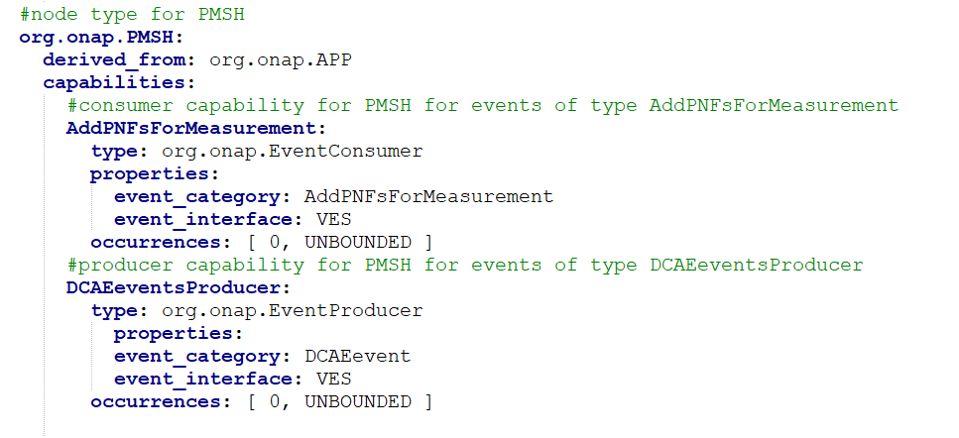
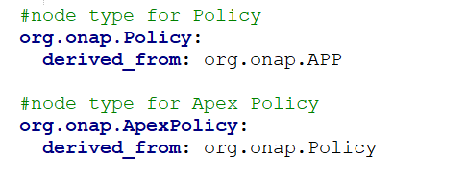
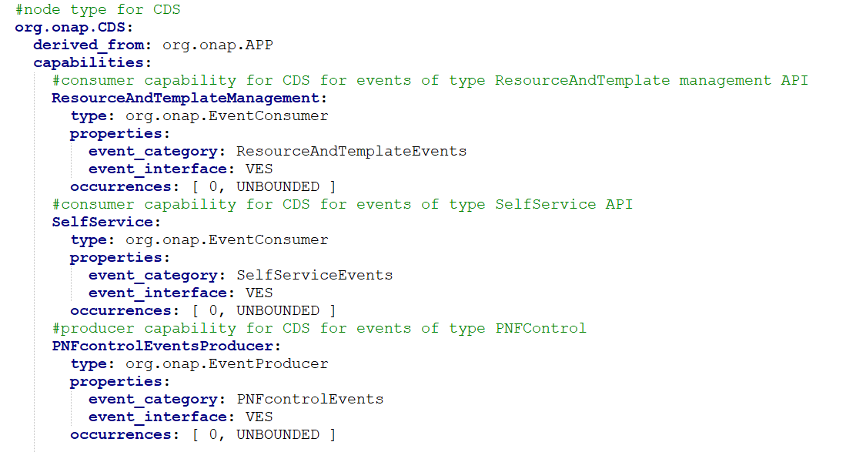
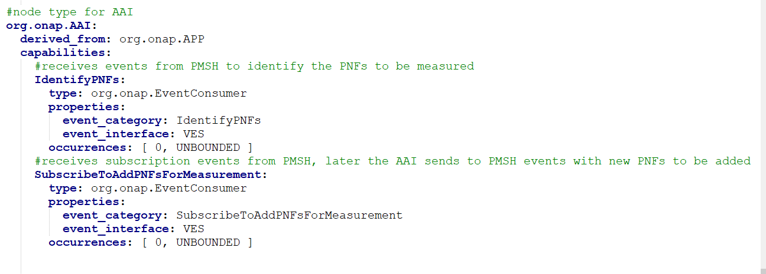
Node Type for PM Control Use Case 1

Slide 15
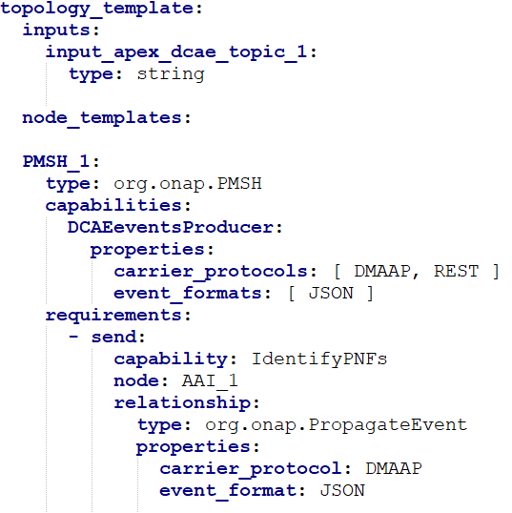
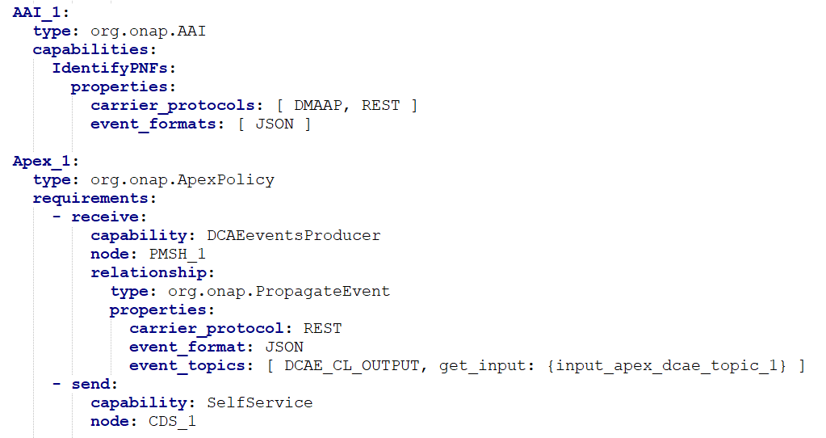
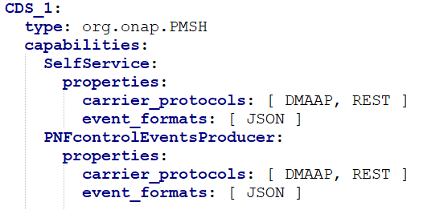
Topology_Template for PM Control UC 1

Slide 16
Closed Loops: UC2 - new PNF instance added in ONAP, default PM measurements (CP1) - Implemented in Rel F
AAI
PMSH
Policy
CDS
AAI notifies to the PMSH a new PNF instance has been discovered/instantiated by ONAP
PMSH will use CP to identify which measurements needs to be activated on the PNF instance
PMSH sends the request to Policy to enable the collection of measurements on the PNF instances
CP1
PNF
EVE1
PMSH
EVE2
Policy
EVE3
CDS
EVE4

Slide 17
Closed Loops: UC3 - new request from UI to activate collection of a new counters (CP2)
UI/APP
PMSH
Policy
CDS
UI/APP can require a change of a CP parameters
PMSH will verify CP updates to identify if a new action need to be triggered towards the network
In case PMSH sends the request to Policy to enable the collection of measurements on the PNF instances
AAI
PNF
CP2
AAI request is optional: it depends on the UI request type
Ie.
UI/3PP App is already providing a PNF ID where measurement collection must be applied
UI/3PP App is identifying an area, PMSH need to check which PNFids belong to

Slide 18
Closed Loops: UC4 – UI can be used to updated CP1
UI/APP
PMSH
Policy
CDS
UI event can require a change of a CP parameters
PMSH will verify CP updates to identify if a new action need to be triggered towards the network
In case PMSH sends the request to Policy to enable the collection of measurements on the PNF instances
CP1
PNF
EVE1
PMSH
EVE2
Policy
EVE3
CDS
EVE4

Slide 19
Closed Loop Architecture

Slide 20
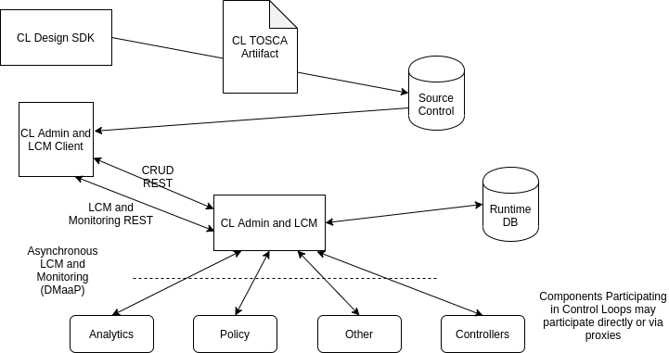
Closed Loop Architecture
CL Design
CL Admin and LCM

Slide 21
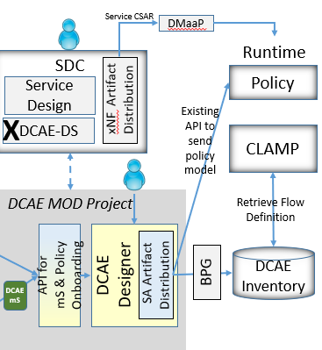
Next Steps
Explore applicability of proposed TOSCA Closed Loop in combination with DCAE MOD.
Is it possible apply APP node type/node template in DCAE Designer ?

