Slide 1

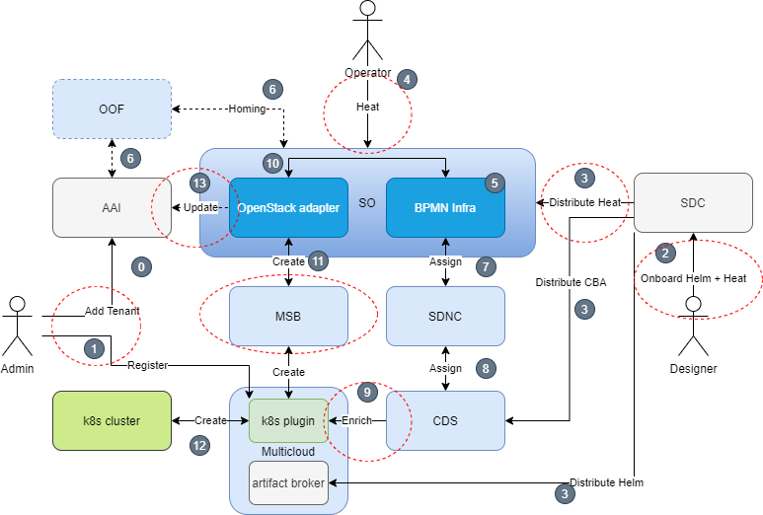
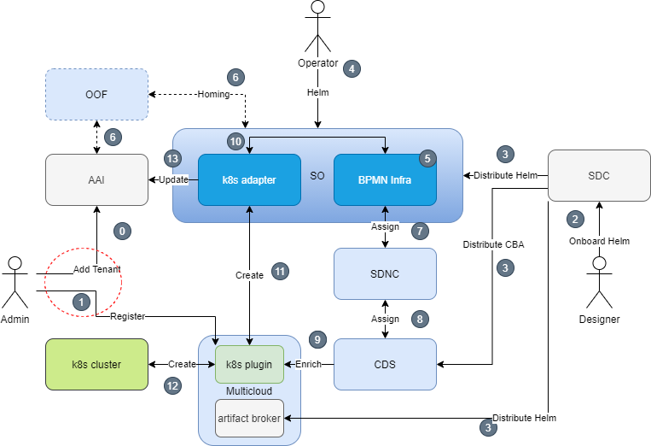
CNF Orchestration in ONAP - Roadmap
Prepared by:: Seshu Kumar (Huawei), Lukasz Rajewski (Orange)
PAST
PRESENT
FUTURE
ONAP
PNF
VNF
CNF
HEAT
TOSCA
HEAT
TOSCA
HELM
HELM
> H Targets
Extension in AAI CNF model
HealthCheck and Monitoring of CNF resources
CDS Native CNF Configuration
Discovery of K8S cluster in ONAP
Cross community Integration.
HELM
HOT
HELM
< Frankfurt Provided
Embedding the helm into the heat package distro
Installation of Helm package into K8s cluster
Basic helm enrichment through CDS
Guilin Brings
Native Helm package support in SDC and SO
Native Helm enrichment support in Controller Design Studio
E2E CNF orchestration chain in all SO components

