Slide 1
VES openAPI Manager (continuation of VES stndDefined)
(3GPP openAPI description presence validator)
Michal Banka, Edyta Krukowska, Damian Nowak, Bogumil Zebek

Slide 2
DCAE – VES Collector – stndDefined 2-step event validation
DCAE VES Collector/EventListener updated to support the stndDefined domain
VES uses DCAE-SDK to validate of JSON objects against an openAPI description
Certain 3GPP openAPIs are built-in VES collector image
  A procedure is available on how to bring addt`l openAPI descriptions using a configMap
Synchronous mode (failure case – object not compliant with schema)
xNF
VES
DCAE-SDK
(JAVA Library)
VES image
msg
/eventListener/v7
JAVA validateJson
(data, schemaReference)
configMap
Addt`l openAPIs
JAVA false
HTTP/400 Bad request
Log event details

Slide 3
DCAE – VES Collector – stndDefined 2-step event validation
Challenge
  Assuming the scope of openAPIs present in the system is extendable (via configMap)
  How does a system operator know, if the openAPIs present in the system are sufficient to validate the events generated by the xNFs?
  Do we have a solution to notify the operator, that he/she might need addt`l openAPIs?
Solutions
  Implement a schemaBroker, which can onboard, store and expose relevant openAPIs
  (Allows to add missing schemas as onboarding, solves #1 and #2)
  Implement a schemaManager, which will use the VES_Event_Registration, and compare the events registered there with the contents of DCAE openAPI configMap
  (Allows to notify, that necessary schemas are, solves #2 only)

Slide 4
DCAE – VES Collector – stndDefined 2-step event validation
Schema broker approach – initial idea:
Pretty complex to execute (changes in many ONAP components), esp. in a short release
{ "event": {
"commonEventHeader": {
"domain": "stndDefined”,
"eventId": „stndDefined-gNB-Nokia000001",
"eventName": „stndDefined-gNB-Nokia-Notification",
"stndDefinedNamespace": "3gpp-FaultSupervision"
},
"stndDefinedFields": {
"schemaReference": https://forge.etsi.org/rep/3GPP/5G_APIs/blob/REL-16/(…)/
S5-201487_fault3gppFields.json#definitions/notifyNewAlarm-NotifType"",
„data":{
"header": {
"uri": "xyz",
"notificationId": "xyz",
"notificationType": "notifyNewAlarm",
"eventTime": "xyz",
"systemDN": "xyz"
},
"body": {
"probableCause": "xyz",
"perceivedSeverity": "Major",
"rootCauseIndicator": false,
"specificProblem": "xyz",
"backedUpStatus": true,
"backUpObject": "xyz",
"trendIndication": "No change",
"thresholdInfo": {},
"monitoredAttributes": [],
"proposedRepairActions": "xyz",
"additionalText": "xyz",
"additionalInformation": [],
"alarmId": "xyz",
"alarmType": "Environmental Alarm"
}
},
"stndDefinedFieldsVersion": ”1.0”
}
}
Only a synchronous call from VES would make it possible to notify the NFs, if sth is wrong
Synchronous call (VES)
JSON validator
lib (DCAE-SDK)
Schema Broker
(e.g. DCAE-CBS)
1st step validation
(VES only)
Schema
API server
Validaton Service API
2nd step validation
(optional)
Validation Service
Schema DB
(JSON doc storage?)

Slide 5
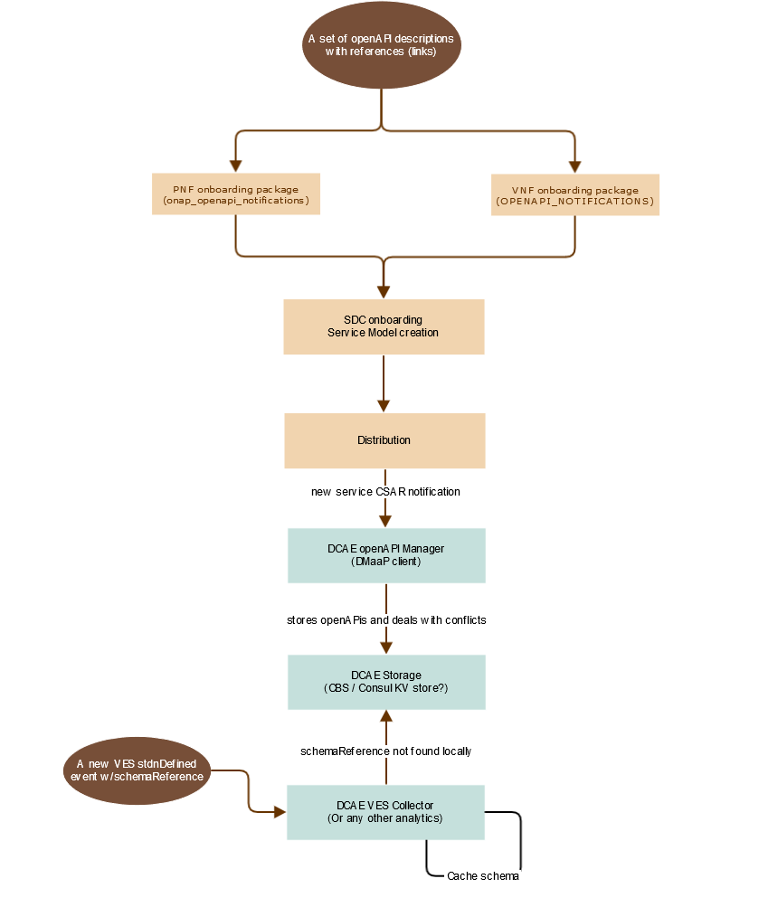
DCAE – VES Collector – stndDefined 2-step event validation
Schema Broker approach
Quite complex (modifications in different components)
Requires extension in the xNF onboarding pkg definitions
Requires a capability to store openAPIs in a volume
Requires an artifact consumption function in DCAE
3GPP openAPIs contain references to other files (not URLs)
paths:
/alarms:
get:
summary: Retrieve multiple alarms
description: >-
Retrieves the alarms identified by alarmAckState, baseObjectInstance
and filter.
parameters:
- name: alarmAckState
in: query
required: false
schema:
$ref: '#/components/schemas/AlarmAckState'
- name: baseObjectInstance
in: query
required: false
schema:
$ref: 'comDefs.yaml#/components/schemas/Dn'
- name: filter
in: query
required: false
schema:
$ref: 'comDefs.yaml#/components/schemas/Filter'
3GPP
FaultMnS

Slide 6
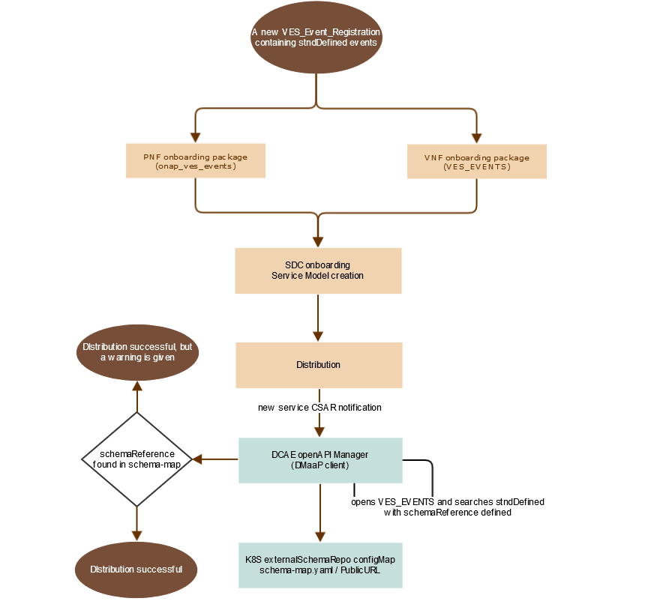
DCAE – VES Collector – stndDefined 2-step event validation
Schema Manager approach
Simplified approach compared to schema broker
Re-uses existing VES_Event_Registration artifact
Compares the declared schema references with existing openAPI schemas loaded in DCAE configMap
stndDefined event registered in VES_Event_Registration file
---
event:
presence: required
comment: "stndDefined event to support 3GPP FaultSupervision NotifyNewAlarm notification"
structure:
commonEventHeader:
presence: required
structure:
domain: {presence: required, value: stndDefined}
(… omitted for brevity)
stndDefinedNamespace: {presence: required, value: "3GPP-FaultSupervision"}
stndDefinedFields:
presence: required
structure:
schemaReference: { presence: required, value: "https://forge.3gpp.org/rep/sa5/MnS/blob/SA88-Rel16/OpenAPI/faultMnS.yaml#/components/schemas/NotifyNewAlarm" }
data: {presence: required}
stndDefinedFieldsVersion: {presence: required, value: "1.0"}
---

Slide 7
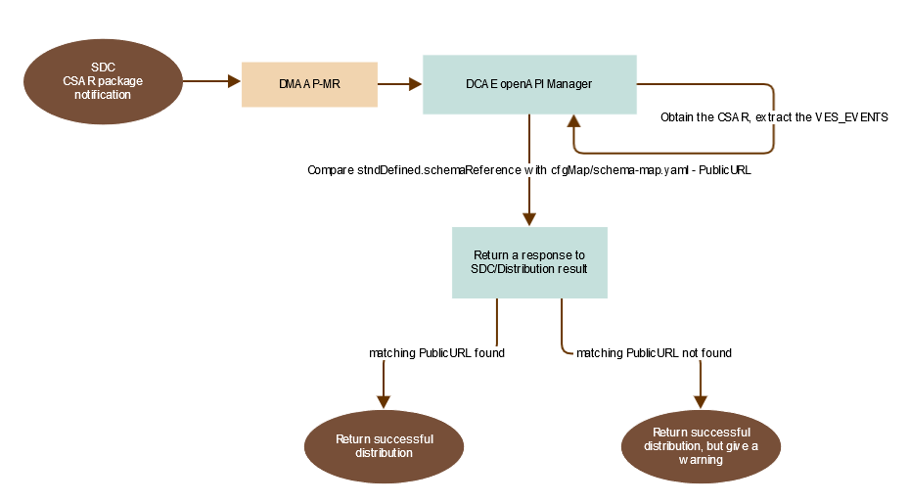
DCAE – VES Collector – stndDefined 2-step event validation
Schema Manager algorithm – in DCAE environment
Fairly simple
Achievable in Honolulu
Potential to create schemaBroker in following releases

Slide 8
DCAE – VES Collector – stndDefined 2-step event validation
Schema Manager use-case summary:
A user on-boards a new xNF package
That package contains stdnDefined events “declaration”
ves-openapi-manager consumes the VES_Events artifact
schemaReferences mentioned are compared against contents of DCAE externalSchema configMap
A user gets warnings in SDC/Distribution, if the xNF uses schemas, which are absent in DCAE externalRepo cfgMap
The warning in SDC doesn`t prevent the service distribution
A user is able to update the cfgMap with relevant openAPIs
There is a script, which is able to generate the cfgMap based on 3GPP openApi descriptions from ForgeETSI GitLAB
A user is able to successfully execute 2nd step of validation with new openAPIs

Slide 9
DCAE – VES Collector – stndDefined 2-step event validation
Schema Manager next steps:
SDC Distribution Client extensions – Done
SDC BE/FE modifications (warning message) – Done
ves-openapi-manger – prototype exists
DCAE Helm charts for ves-openapi-manager – prototype exists
DCAE update to always use a configMap with external openAPI descriptions – to be done
Further steps to migrate SchemaManager to become schemaBroker for openAPI descrpitions – “I” release
Recommendation (DCAE weekly Jan 6th 2021):
Implement ves-openapi-manager, as DCAE platform component, optionally enabled in DCAE Helm

